Slide 1
Human capital matters: Market valuation of firm investments in training and the role of complementary assets
Riley, Michael, and Mahoney (2017)
BADM 549 Youngsir Rha

Slide 2
Summary
Research questions
Q1: Can investments in general training be beneficial for firms financially?
Q2: What (firm-level) factors influence the variance of the returns?
Methodology
Q1: Event study. Event is the release of information that firms were awarded with “training top125”. Analyzed their abnormal stock market returns.
Q2: Regression analysis to test hypotheses regarding complementary relationships
Results
Signal of effective investments in human capital training leads to positive stock price reaction
Human capital investments are more impactful when there are complementary investments in R&D, physical capital, and advertising investments
Human capital matters!

Slide 3
Literature Review
Resource-based View
Resources that are valuable, inimitable, nonsubstitutable, and organizationally embedded (VRIO) can result in a firm’s superior financial performance.
Investments in human capital are potential sources of such resources of sustainable competitive advantage because they are intangible, tacit, inimitable.

Slide 4
General Training vs Firm-specific Training
Traditional views
General training (GT) provides skills that are also useful in other firms (competitors). With GT, employee’s employability increases because other firms can also capture some of the returns from training, while not making investments themselves.
Regarding firm-specific training, the firm is expected to gain at least some of the economic returns from training that increases productivity when the human capital is firm-specific (Coff, 1997; Harris & Helfat, 1997; Hashimoto, 1981).
RBV suggests that firms are willing to make investments in firm-specific human capital because the tacit, complex, and causally ambiguous nature of these intangible investments makes imitability difficult (Lippman & Rumelt, 1982; Rumelt, 1984).
Only firm-specific human capital qualifies for resources that lead to higher financial performance.

Slide 5
Literature Review
Becker (1964)
Premise: competitive labor market, poached worker can immediately and painlessly start working, and yield full value, in a job commensurate with his training. This implies that transactions costs are negligible, potential recruiting firm has full information regarding training in other firms, and there are no costs related to such absence of information.
Human capital investments in the training and education of employees can have positive economic value because they develop and nurture the knowledge and skills of these employees, thereby improving their productivity.
Wage rates, which are determined by marginal productivity in other firms, would rise by the same amount as the marginal product and the firms providing the training cannot capture any of the return.
Meanwhile, the competitors can hire out the workers at a higher wage because they don’t bare the cost of training. They can attract a worker with such training by outbidding the firm which trained him → Firms that provide GT will lose its trained workers!

Slide 6
What happens in a not perfectly competitive labor market?
Coff et al. Identified market frictions that may allow for increase in financial performance even when the training is general.
Supply side
Employee’s willingness to move is weak because they are bounded by market frictions.
Job search is costly and time consuming.
Training is a signal to employees that firms are committed to them.
Demand side
It is difficult to measure the value of the training program,
Employee’s productivity may not remain the same in the new firm
Uncertain which part of training is useful for new firm
Instantaneous adjustment suggested by Becker is not certain due to delay in mobility
→ Big cost of moving and uncertain benefit of training to the hiring firm calls for significant market frictions

Slide 7
Departure from extant literature
Labor market frictions can also create competitive advantage through training and other HC investments.
Previous studies looked at non-financial implications of HC investment and training. This paper investigate the financial performance implications.

Slide 8
Hypothesis for financial implication of HC investment
Due to adjustment costs of employees, the firm that provides general training may be able to retain generally trained employees while paying them less than their full marginal product and keeping the remaining economic returns from training.
As for firm-specific training, the firm will gain some of the economic returns from training via increased productivity. Also, RBV suggests that firm specific, tacit, and ambiguous intangible investments makes it hard to imitate.
Thus, investments in both (effective) general training and firm-specific training have potential to yield sustainable competitive advantage.
“One measure of that advantage is the positive stock price reaction to new information demonstrating the magnitude and efficacy of those investments”
H1: A signal of firms’ effective investments in human capital leads to a positive stock price reaction.

Slide 9
Complementarities
Complementary activities: doing more of any one activity increases the marginal profitability of each of the other activities.
RBV: higher financial performance can be achieved by investing in complementary resources
Previous studies show that HC and organizational resources are complementaries.
Amit and Schoemaker (1993): “strategic assets” are firm-specific, intangible, and tacit resources and capabilities that are subject to market frictions that generate organizational rents. Also complementary to other strategic assets of the firm.
→ This paper tests this hypothesis to find the complementaries to HC investment

Slide 10
Hypotheses for complementaries
H2: The higher the firms’ R&D intensity, the greater the positive stock price reaction to the signal of effective investments in human capital.
H3: The higher the firms’ physical capital intensity, the lesser the positive stock price reaction to the signal of effective investments in human capital.
H4: The higher the interaction of R&D intensity and physical capital intensity, the greater the positive stock price reaction to the signal of effective investments in human capital.
H5: The higher the firm’s advertising intensity, the greater the positive stock price reaction to the signal of effective investments in human capital.

Slide 11
Methods
Event study for H1
Event: the announcement that a firm has received a Training Top 125 award.
This event (information) is a signal that can lead to significant abnormal returns.
Regression analysis for H2-H5
Regression analysis to test hypotheses regarding complementary relationships between firm-level factors and human capital investments
Analyze abnormal returns to explain variance using measures of complementary assets
Sample
Public firms receiving the awards during the time period of 2005–2008 (219 events involving 99 business units of 95 parent corporations)
Measurements
DV: cumulative abnormal returns
IV(measured in the year before the award):
R&D intensity – R&D investment divided by sales
Physical capital intensity – physical capital investment divided by sales
Advertising intensity – advertising expenditures divided by sales
Controls: firm size, whether the award was for the entire corporation or a division, whether the firm won an award in the previous year, and industry

Slide 12
Results

Slide 13
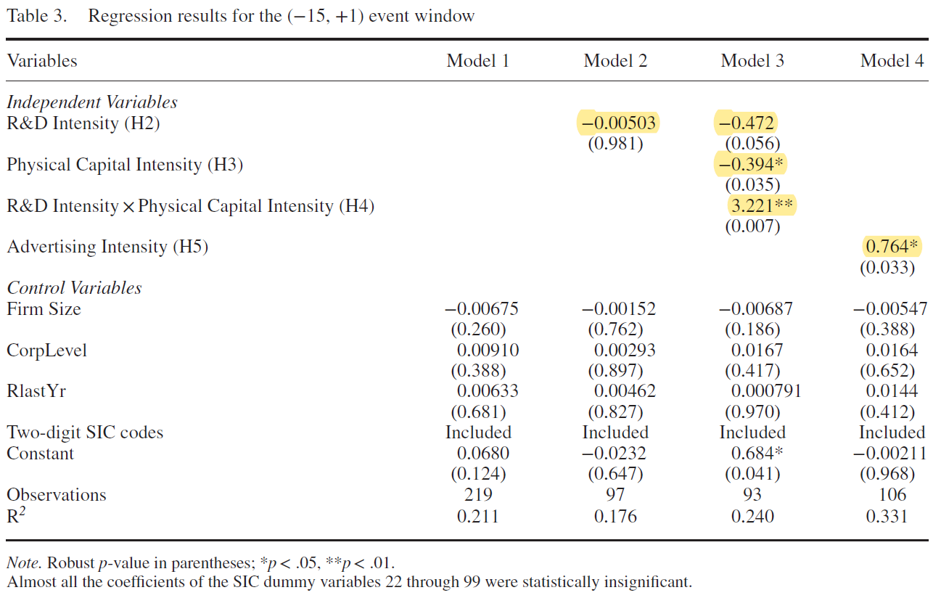
Results

Slide 14
Conclusion
Signal of effective investments in human capital training leads to positive stock price reaction.
Human capital investments are more impactful when there are complementary investments in R&D, physical capital, and advertising investments
Human capital matters!
Both general training and firm-specific training have positive financial implications for the providing firm.

